Slide 1
Internet Start After World War 2nd

Slide 2
ALLIES
World War 2nd
AXIS
US, Russia, China, Britain
Germany, Japan, Italy

Slide 3
Russia
USA
SPUTNIK
First ManMade Satellite
Agency
ARPANET
Advance Research Project Agency Net.

Slide 4
ARPANET Login LO transferd 1983 TCP/IP

Slide 5
Team Berner li 1990s WWW HTTP HTML

Slide 6
DNS IPV4 32 Bit Ping Google.com

Slide 7
How Data Transferd
Suraj ------------ Whatsapp ----------------------- Sudheer
Hey Breakdown into Packets
End-to-End Encripyted
Encription/Decripytion

Slide 8
Packets
Headers : Receiver IP, Sender Ip Meta Data: timestamp

Slide 9
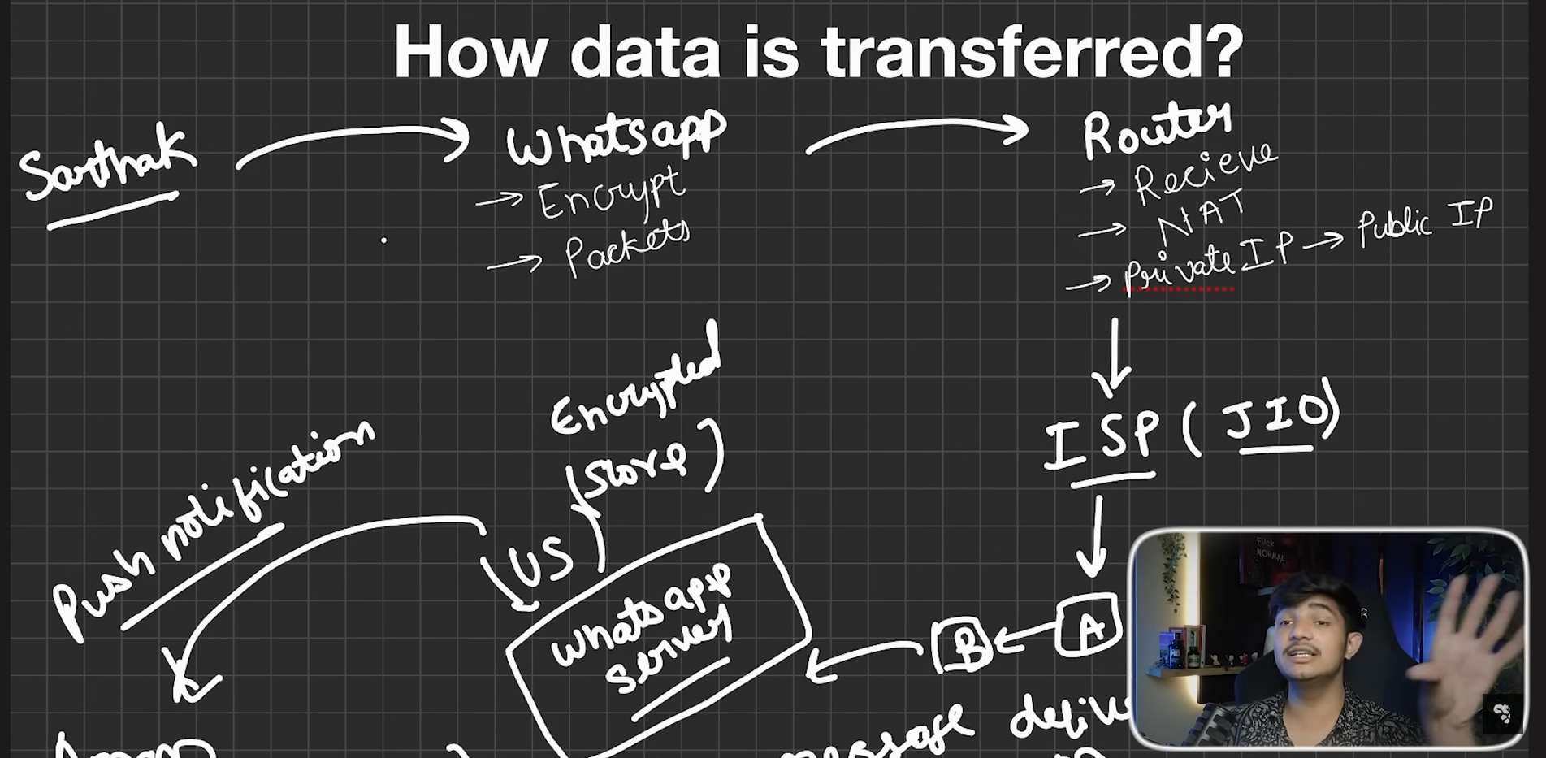
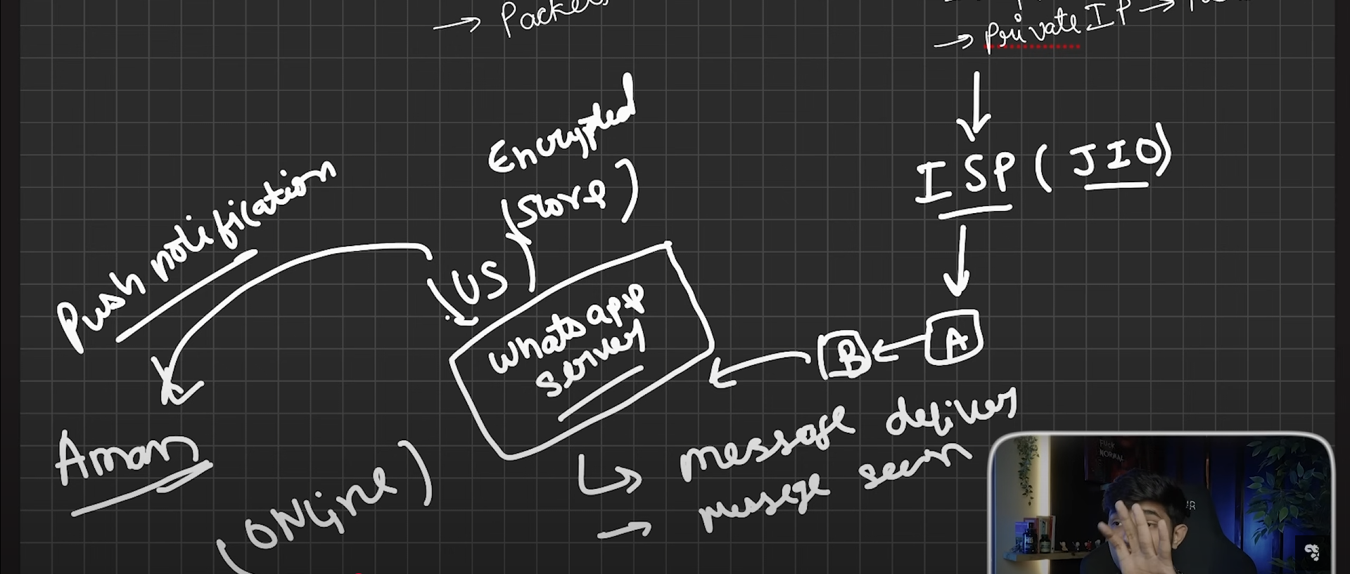


Slide 10
IPV4 IPV6
4.3 Billions Devices 3.4*10³⁸

Slide 11
Port Number 65,535 0-1023 (System Ports) 1024-49151 (Application Ports) 49152-65,535(Temporary Ports)

Slide 12
DNS : Domain Name System
admin.suraj.com
Subdomain,Second,top

Slide 13
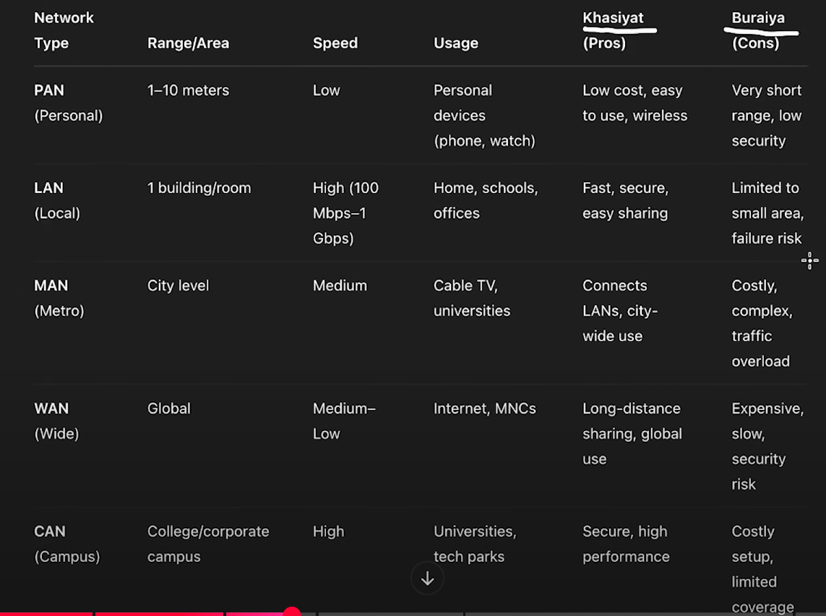
Types of network PAN LAN CAN MAN WAN

Slide 14
VPN by Proxy Hide IP

Slide 15
Topologies BUS RING Star Mesh Tree Hybrid

Slide 16
OSI Model Open System Interconnection Developed by ISO > 1984

Slide 17
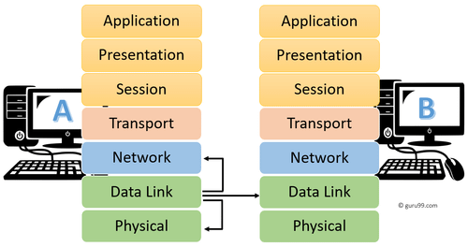

Slide 18
Application: DNS>IP HTTP, SMTP, FTP Presentation: Translation, Compression, Encryption Session Layer: Time Interval, Checkpoints Transport: Segmentation, Packet Form, Sequencing, Acknowledgement, Resend Network: IP Assign, Routing, Data link Layer: MAC Address, Port No. Physical Layer:Encoding, Bits, Radio Waves > Means Raw Data Transmission

Slide 19
How Computer Communicate Client Server Architecture Peer to Peer

Slide 20
Protocols Set of Rules

Slide 21
Types of Rules 1. HTTP and HTTPS hyper text transmission Protocol Application Layer Protocol HTTP+Security HTTPS>Encriyption

Slide 22
IP (Internet Protocol) Network Layer Protocol Source IP > Destination IP

Slide 23
TCP (Transmission Control Protocol) Packets Sequencing ACK Resend

Slide 24
UDP (User Datagram Protocol) Fast travel Sequencing X ACK X

Slide 25
TCP UDP
Bank
E-Com
Live
Game
Video Call
Voice Call

Slide 26
